Slide 1

AXIORA 2026
ThriveMind
AI Powered Mental Health Assessment
CHIGURU DINESH REDDY
JAKKA HRUSHIKESH BABU
KOLA KRUTHI
Team Presentation

Slide 2

The Challenge
The Problem We're Solving
1 in 5 People Affected
Mental health issues impact 20% of the global population, yet awareness and access to assessment remain critically low.
Unknown Status
Most individuals are unaware of their mental health condition, lacking accessible tools for self-assessment and early detection.
No Easy Access
There is no private, instant, and user-friendly self-assessment tool available for people to check their mental wellness.
The Gap
Stigma Barrier
Millions need help but have nowhere to turn for a quick, private assessment.
Social stigma prevents many from seeking professional help, creating a critical gap in mental health care accessibility.

Slide 3

Our Approach
Our Solution: ThriveMind
AI-Powered Assessment
Intelligent Mental Health Checker
ThriveMind leverages advanced AI to provide instant, accurate mental health assessments through a simple, conversational interface.
10
100
AI
ThriveMind
Scientifically Designed Questions
Instant Score Out of 100
Personalized Suggestions
Our Mission: Make mental health assessment accessible, private, and stigma-free for everyone, everywhere.

Slide 4
User Journey
How ThriveMind Works
1
2
3
4
User
10 Questions
AI Analysis
Score + Suggestions
Anyone seeking a quick mental health check visits our platform
Answer scientifically designed questions across 10 key areas
Google Gemini API processes responses intelligently
Receive instant score and personalized recommendations
2 Minutes
100%
Any Device
Complete Assessment
Private & Secure
Works Everywhere

Slide 5
Comprehensive Assessment
The 10 Assessment Areas
Holistic evaluation across all dimensions of mental wellness
Emotional Stability
Sleep Quality
Social Connection
Sense of Purpose
Anxiety Levels
Ability to manage and regulate emotions effectively
Restfulness and consistency of sleep patterns
Quality of relationships and social support network
Feeling of meaning and direction in life
Frequency and intensity of anxious thoughts
Self-Talk
Focus & Clarity
Physical Care
Stress Coping
Future Hope
Nature of internal dialogue and self-perception
Ability to concentrate and maintain mental clarity
Attention to physical health and self-care routines
Effectiveness of stress management strategies
Optimism and positive outlook toward the future
Comprehensive Coverage: Every aspect of mental wellness evaluated for a complete picture

Slide 6
Clear Results
Our Scoring System
Five-tier framework for actionable mental health insights
80-100
Thriving
Excellent mental wellness. Continue current practices and maintain healthy habits.
Good
60-79
Solid mental health with room for improvement. Focus on specific areas for enhancement.
Needs Attention
40-59
Moderate concerns detected. Implement suggested strategies and monitor progress.
Seek Support
20-39
Significant challenges identified. Consider professional help alongside self-care practices.
Crisis Support Needed
<20
Immediate professional intervention recommended. Crisis resources provided.

Slide 7
Tailored Guidance
Personalized Suggestions
5-level recommendation system for every assessment area
Crisis Level
1-2
Immediate professional help recommended. Crisis hotlines and emergency resources provided.
AI-Powered Personalization
Low, Needs Work
Google Gemini API analyzes each response to generate context-aware, actionable suggestions tailored to individual needs.
3-4
Significant improvement needed. Structured self-help strategies and routine changes suggested.
5-6
Moderate
Room for growth identified. Practical tips and habit-building exercises recommended.
Example Flow
7-8
Good
Sleep Quality Score: 4/10
Solid foundation present. Fine-tuning suggestions to reach optimal wellness.
Category: Low, Needs Work
9-10
Excellent, Maintain It
Suggestions: Sleep hygiene routine, screen time limits, relaxation techniques
Outstanding performance. Reinforcement strategies and maintenance tips provided.

Slide 8
Built With Modern Tech
Technology Stack
Robust, scalable, and accessible architecture
Frontend
AI Analysis
User Interface
Intelligence Engine
HTML5
Google Gemini API
Structure & semantics
Advanced NLP & reasoning
CSS3
Processes user responses and generates personalized insights using state-of-the-art language models
Styling & animations
JavaScript
Interactivity & logic
Backend
Hosting
Server & Logic
Deployment
Python
GitHub Pages
Core backend language
Free, reliable hosting
Streamlit
Live Link: Accessible anywhere, anytime with zero cost
Web app framework

Slide 9
See It In Action
Live Demo Preview
Clean, intuitive interface designed for seamless user experience
thrivemind.github.io/assessment
thrivemind.github.io/results
72
Mental Health Assessment
Your Mental Health Score
Question 3 of 10
Good
How well have you been sleeping lately?
Key Insights
Very well - restful and consistent
Emotional Stability
8/10
Fairly well - occasional issues
Sleep Quality
5/10
Social Connection
9/10
Not great - frequent disruptions
Poor - significant sleep problems
Previous
Next Question
Suggestion: Focus on improving sleep hygiene. Try a consistent bedtime routine.

Slide 10
Why Choose ThriveMind
Key Features & Benefits
Designed with user needs at the center
Completely Free
100% Private
Universal Access
No cost, no subscriptions, no hidden fees. Mental health assessment accessible to everyone regardless of financial situation.
No data stored, no tracking, complete anonymity. Your responses are processed in real-time and never saved anywhere.
Works on any device, any browser, any operating system. Desktop, tablet, or mobile - experience remains seamless.
No Login Required
Instant Results
Actionable Suggestions
Zero barriers to entry. No account creation, no passwords to remember, no email verification. Just visit and assess.
Get your score and personalized suggestions immediately after completing the assessment. No waiting, no delays.
Not just numbers - receive practical, evidence-based recommendations you can implement immediately to improve.

Slide 11
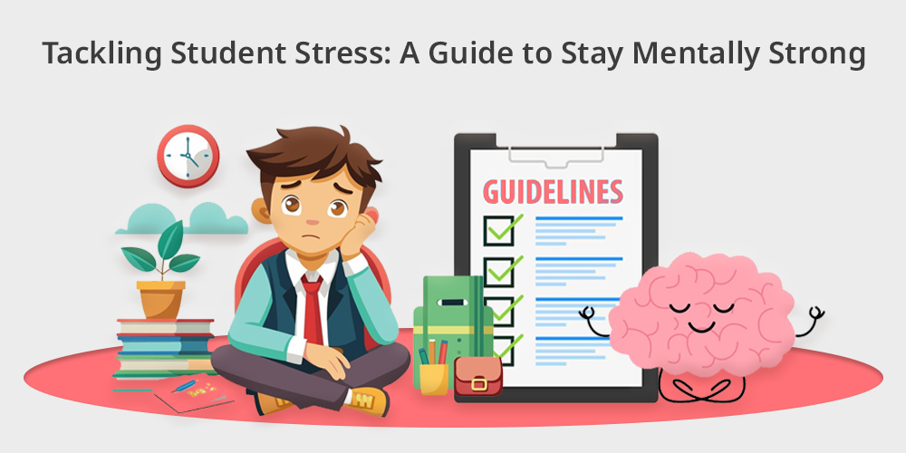
Real-World Applications
Impact & Use Cases
Making a difference across diverse populations
Students
Academic pressure, exam stress, and social challenges take a toll on student mental health. ThriveMind provides a quick, stigma-free way for students to check in with themselves.
Exam Stress
Social Anxiety
Study Pressure
Student Wellness
Working Professionals
Burnout, work-life imbalance, and career stress affect millions. ThriveMind helps professionals identify early warning signs and take preventive action.
Integration Potential
Burnout Prevention
Work-Life Balance
Career Stress
ThriveMind can be seamlessly integrated into college counseling systems, employee wellness programs, and healthcare platforms.
General Public
Anyone wanting a quick mental health check can benefit. Whether you're feeling off or just want to maintain wellness, ThriveMind is here.
University counseling portals
Corporate wellness programs
Wellness Check
Early Detection
Self-Awareness
Healthcare provider websites

Slide 12

Thank You
Your mental health matters
Live Demo
thrivemind.github.io
Experience ThriveMind now - completely free, private, and instant
Contact
GitHub
Website
team@thrivemind.io
github.com/thrivemind
thrivemind.io
AXIORA 2026

